Slide 1
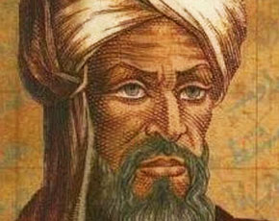
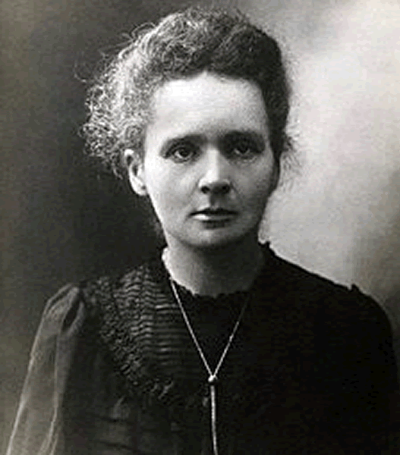
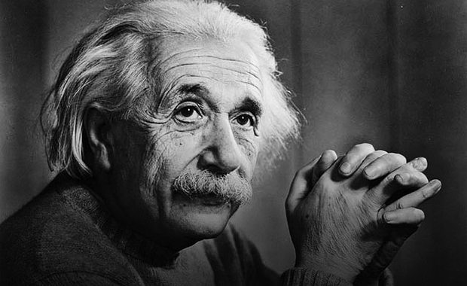
Grade SixUnit 9
Student’s Book Page 74
Famous people

Slide 2
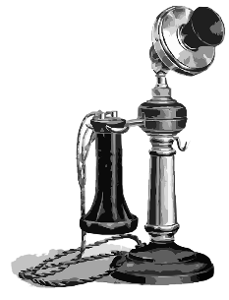
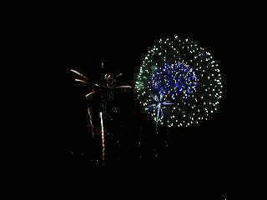
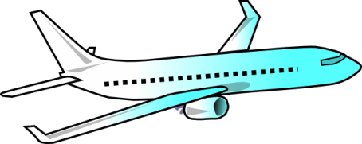
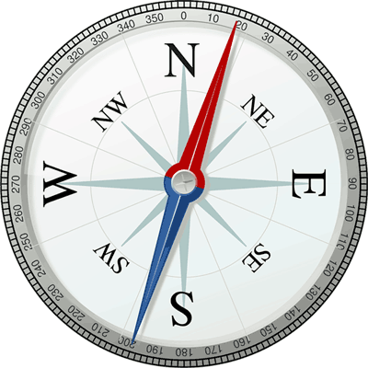
11. Match the people with what they did. Make and say sentences.
the telephone. fireworks. the plane. the compass. | invented | The Arabs A.G. Bell The Chinese The Wright brothers

Slide 3
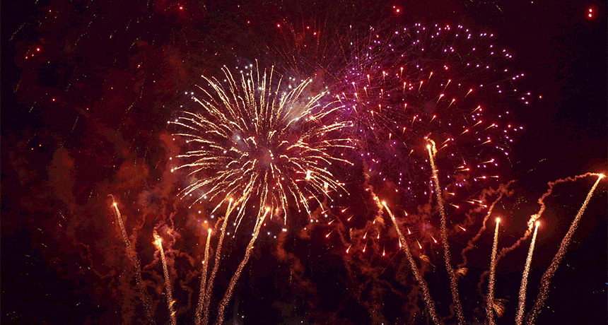
Who invented the fireworks?

Slide 4
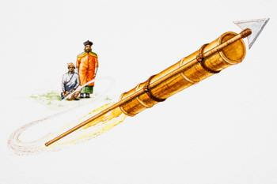
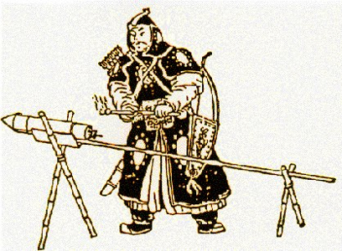
The Chinese invented the fireworks.

Slide 5
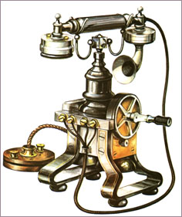
Who invented the telephone?

Slide 6
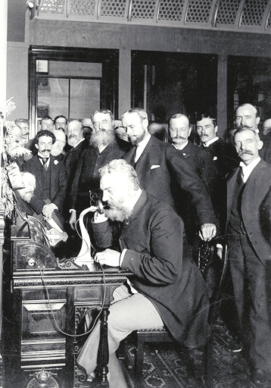
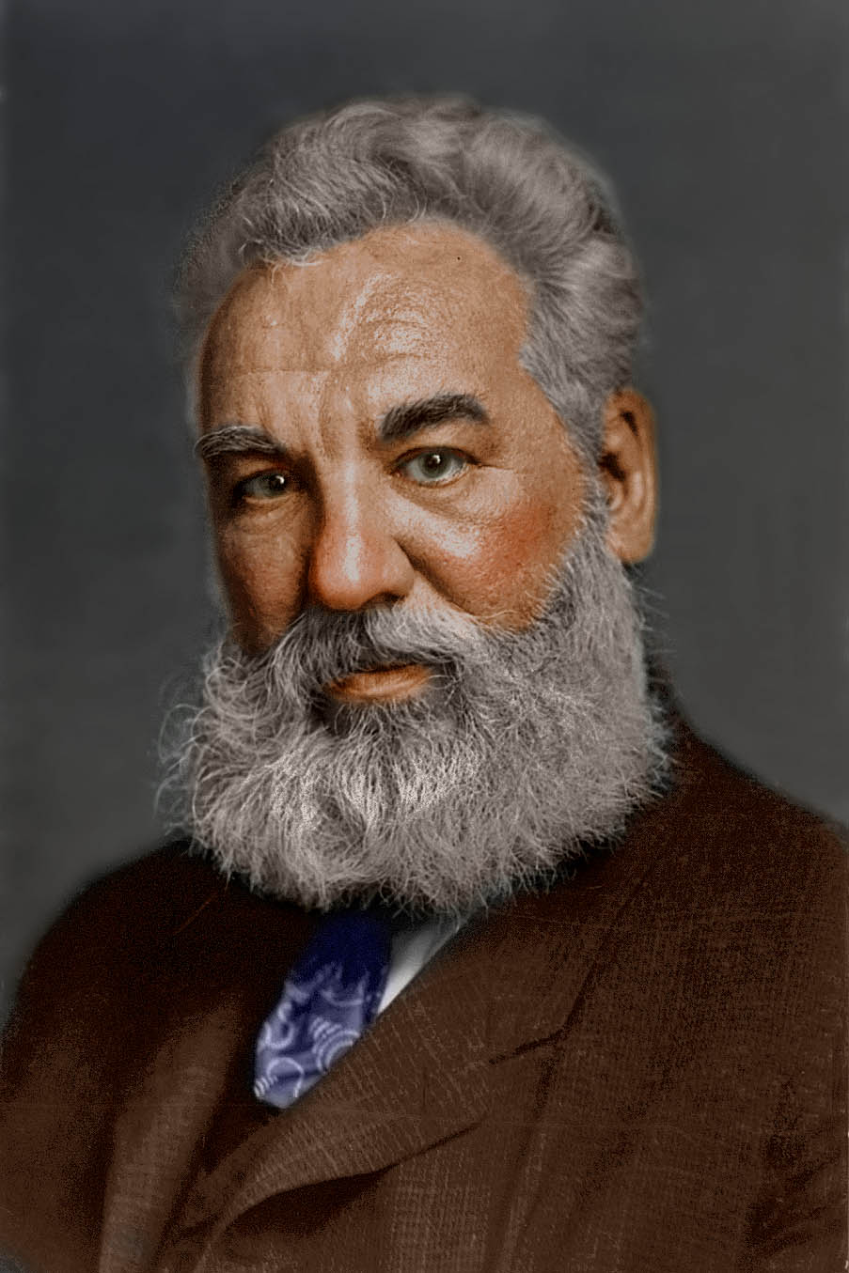
A. G. Bell invented the telephone.

Slide 7
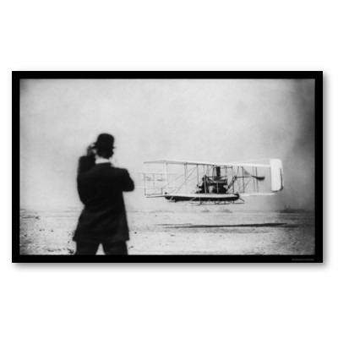
Who invented the plane?

Slide 8
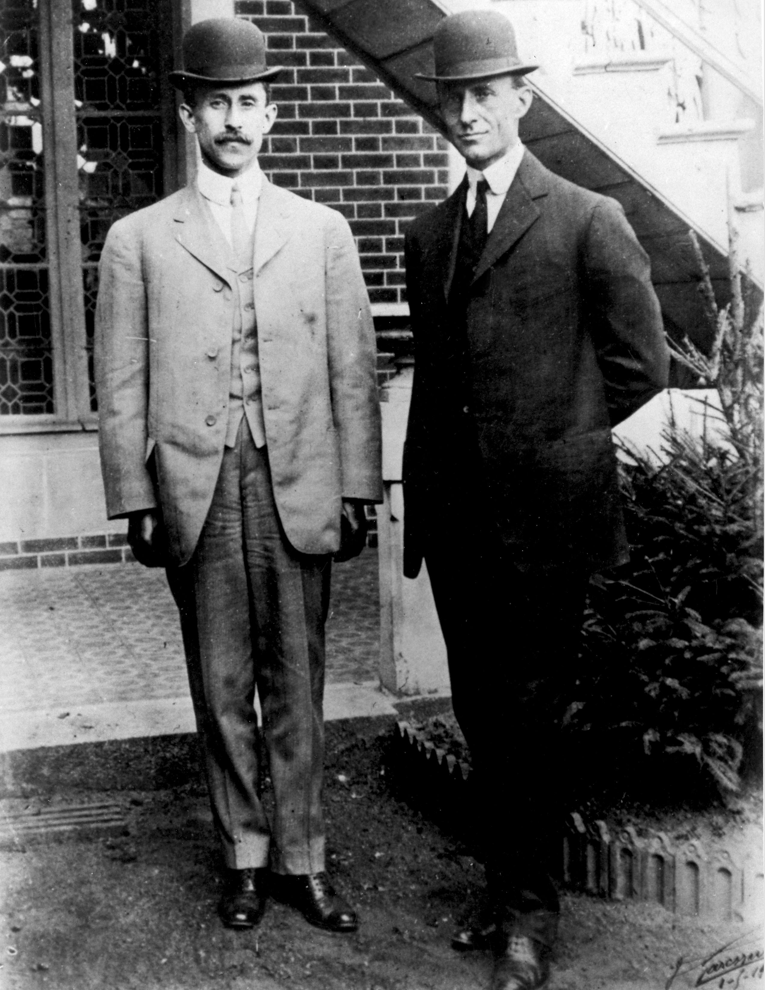
The Wright brothers invented the plane.

Slide 9
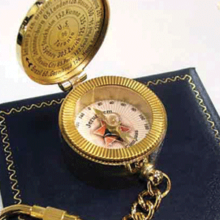
Who invented the compass?

Slide 10
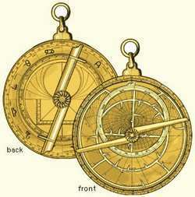
The Arabs invented the compass.

Slide 11
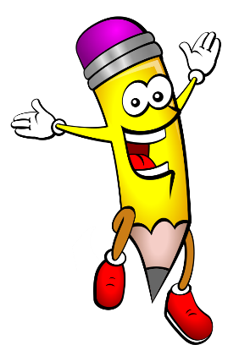
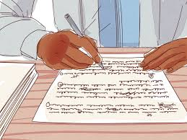

Slide 12
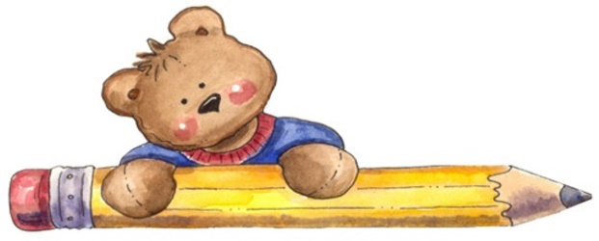
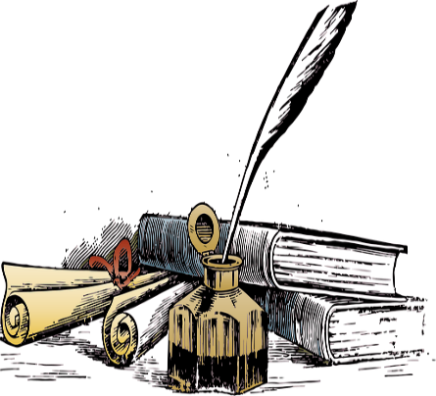
12. Write about a famous man or woman.
Use the following questions to help you.
When was he/she born? Where did he/she come from? Did he/she go to university? What did he/she study? What did he/she do to be famous? Did he/she win any prizes? How did he/she help people? How did he/she die? When did he/she die?
-the topic sentences. -the supporting details. -punctuation marks. -surf the net for useful information. -write the topic in your notebook.
Answer the questions in paragraphs. Each colour is a different paragraph.

Slide 13
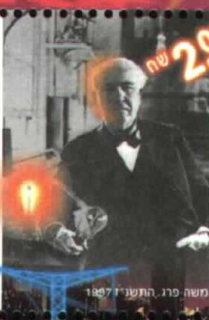
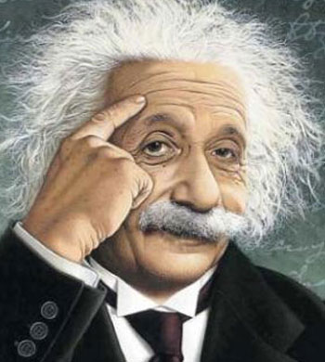
First, choose a famous man or woman.

Slide 14
When was he born? Where did he come from? Did he go to university? What did he study? What did he do to be famous? Did he win any prizes? How did he help people? How did he die? When did he die?

Slide 15
When was she born? Where did she come from? Did she go to university? What did she study? What did she do to be famous? Did she win any prizes? How did she help people? How did she die? When did she die?

Slide 16
-the topic sentences. -the supporting details. -punctuation marks. -surf the net for useful information. -write the topic in your notebook.

Slide 17
Choose one famous person to write about
Alexander Graham Bell:
Born in March 3, 1847 in Scotland.
He went to the University of Edinburgh.
He studied Science.
He invented the telephone.
He won many prizes.
He helped people to communicate easily with each other.
He died from diabetes on August 2, 1922.
Marie Curie:
Born in November 7, 1867 in Poland.
She went to the University in Paris
She studied Physics and Maths.
She did many researches in Science.
She won two Nobel Prizes.
She worked hard to help people by finding a cure for cancer.
He died from cancer on July 4, 1934.

